Slide 1









DATS 6103 Project 1 World Military Spending By: Andrew Jones

Slide 2

Table of Contents
Project Background and Goals 3
Top 10 countries for military expenditure 4
Top 10 countries for military expenditure relative to Gross Domestic Product (GDP) 5
Which countries spend the most of their GDP on defense? 6
Military Spending of Top 10 Countries relative to the rest of the world 7
Ratio of Per Capita GDP to Per Capita Military Spending 8
Fastest Growing Military Spending (Fixed $) 9
Fastest Growing Military Spending (Average % Growth) 10
Bonus Question: When will Chinese military spending surpass the USA 11
Conclusions 12
Sources and Learning Process 13

Slide 3


Project Background and Goals
Stockholm International Peace Research Institute: SIPRI Military Expenditure Database
Database provided a comprehensive view of Military expenditures by many dimensions meaning I was able to avoid joining disparate datasets
Dataset
Manually reduced the data set to analyze the years 1992 - 2016
Choosing more recent years allowed for more complete and accurate data
Choose the year after the fall of the USSR – arguably puts all military spending within the same geo-political paradigm
Data Preparation
Describe persistent themes and interesting trends within world military spending at the international level
Highlight where military spending is most varied, changing or static
Ask insightful questions for further analysis
Analysis Goals

Slide 4
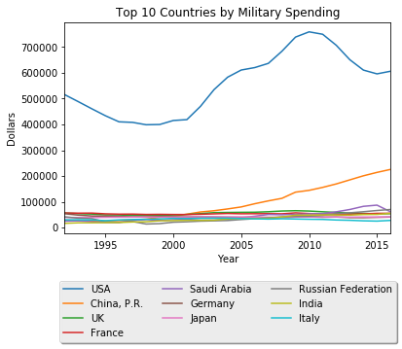

Top 10 Countries by Military expenditure Since 1992
Theme 1: Military Spending of the United States clearly dwarfs other countries
Theme 2: Notable rise of the military spending for People’s Republic of China

Slide 5
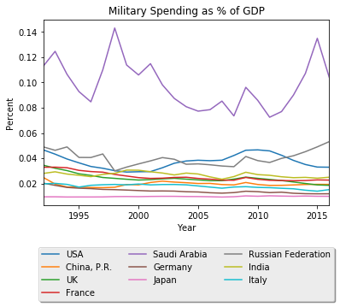
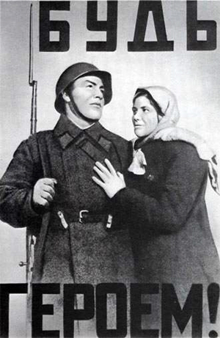

Military Spending Compared to GDP
Theme 3: When viewed as a percentage of GDP however the picture shifts slightly. Saudi Arabia is spending a very high percentage of GDP on defense
Notable rise in the percentage of GDP spent by Russia
Is the decline in the United states spending as a percentage of GDP a function of GDP rising or military spending falling?

Slide 6
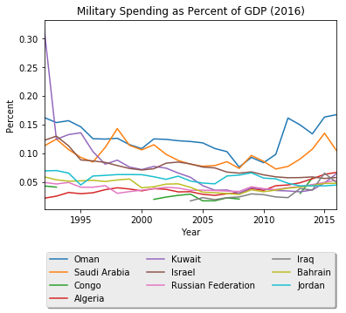
Highest Military Expenditure Countries as a Percent of GDP
When looking at countries that spent the highest share of their GDP in the year 2016 interestingly the only countries to remain on the list are Saudi Arabia and Russia
Russia is also a known as a large arms exporter – while they spend a large amount on defense as a percent of GDP, is producing arms also a large contributor to GDP or Gross National Income (GNI)?

Slide 7
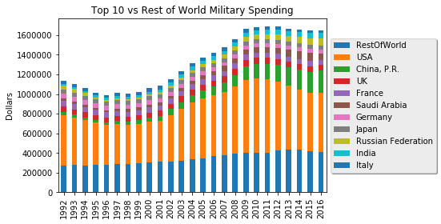
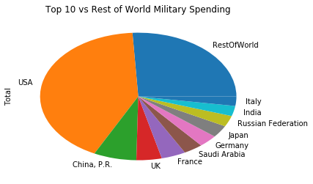
Compare top 10 countries to rest of world
Theme 1: In fixed dollars the United States has consistently spent a huge percentage of the worlds military output.
Theme 2: China’s spending among countries has rapidly risen from 10th place on this list in 1992 to second by 2016 (excluding “rest of world”)
Notable that the top 10 (out of 193) countries spent around 75% of the world’s total spending on defense over the period of 1992 to 2016
Theme 1: The United States alone spent approximately 40% of the world’s total spending in the same period

Slide 8
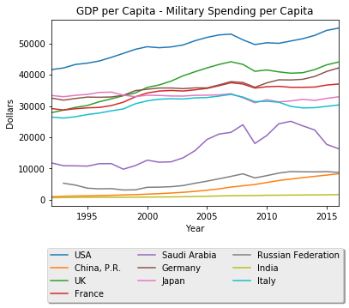

Per Capita GDP vs Per Capita Military Spending (Question 4)
This chart shows the difference between Per Capita GDP and Per Capita Military Spending for the original Top 10 military spending countries
Per capita GDP is rising faster than per capita military spending for the United States and most of our core countries being analyzed
Theme 3: Saudi Arabia is the only country that is clearly spending more of their per capita GDP on defense. Per capita military spending is rising faster than per capita GDP. This could be due to the steep decline in the price of oil.

Slide 9
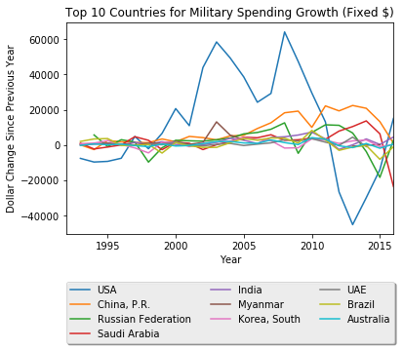

Fastest Growing Military Spending (Fixed $)
Small percentage swings in the US military budget appear as large fixed dollar swings relative to other countries – because we spend so much
It’s clear to see the build up of the Iraq & Afghanistan Wars and then the sequestration under the Obama Administration
Interesting that Myanmar made the list

Slide 10
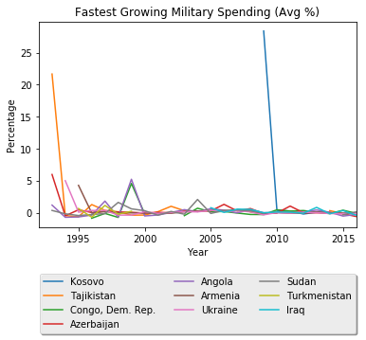
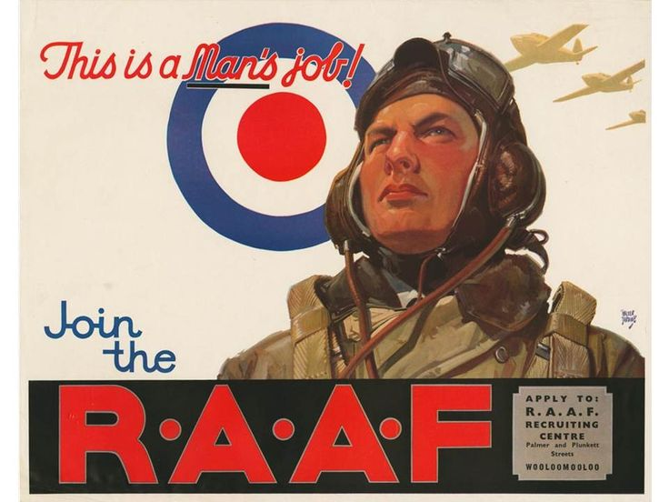
Fastest Growing Military Spending (Avg % Growth)
When viewed as a simple percentage growth we get a whole new set of countries to analyze
Kosovo (dark blue) was a new country that didn’t start having reliable spending metrics until 2009
Just because these countries have had a very high average spending growth, doesn’t mean they are spending a lot. They are starting from a very small spending amount originally in 1992 (or later).
It is unsurprising that this measurement would be the easiest way to target world “hotspots” over the period analyzed. Many, if not most of these countries have experienced armed conflict over the period analyzed.

Slide 11
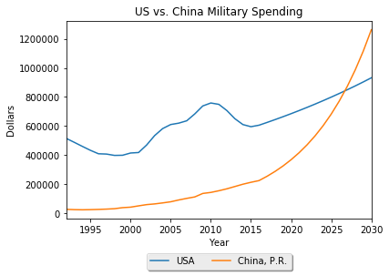
Bonus Question: When will Chinese military spending surpass the USA?
Measured average growth rate of both countries over the examined period and extended that rate out for our forecast
With this very simplistic forecasting method it appears that if China maintains it’s pace of military spending growth it’s compound interest effect will have it outspending the USA by 2027
In practice much more advanced forecasting methods (maybe ARIMA) and qualitative factors would be combined for a more accurate forecast – this was just for demonstration purposes
Furthermore it is worth noting that these “official” figures for Chinese military spending may not reflect reality due to opaque accounting standards and general lack of transparency. (china power)

Slide 12
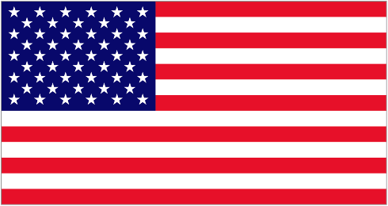



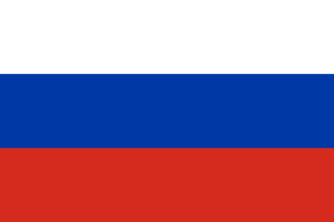
Conclusions
Theme 1: USA still dominates
The United States dominates the world in terms of military spending as a fixed amount. Because it’s a nation with a very high GDP however, as a percentage of GDP it is within the normal range for a top spending nation.
In fact it does not even make the top 10 list when viewed strictly for countries that spend the most of their GDP on defense. Even if that spending amount is orders of magnitude smaller in most cases.
Theme 2: China is clearly a rapidly rising power
The People’s Republic of China’s military output is increasing steadily
However their GDP growth is outpacing their military spending growth per-capita meaning they are not spending a comparatively large amount relative to their growth.
Theme 3: Saudi Arabia is in many ways an outlier
Saudi Arabia was the only country that was having their military spending per capita outpaced by GDP growth
For a top 10 spending country, it was also spending almost double GDP per capita on defense than the next nation
UN Security Council Permanent Members

Slide 13
Learning Process and Sources
Learning Process:
Data Wrangling was key to the learning process
Certainly saw myself develop in capability as I went through – code became more concise
In some ways had to prioritize and limit what “above and beyond” items I wanted to take on – appropriately scope my program
Sources
Stockholm International Peace Research Institute: SIPRI Military Expenditure Database
“SIPRI Military Expenditure Database .” STOCKHOLM INTERNATIONAL , www.sipri.org/databases/milex/
UN Security Council
“Current Members.” United Nations Security Council, www.un.org/en/sc/members /
Chinese Spending Transparency
China Power Team. "What does China really spend on its military?" China Power. December 28, 2015. Updated August 4, 2017. Accessed October 14, 2017. https://chinapower.csis.org/military-spending/
Posters
“World War II Propaganda (Vintage Art).” AllPosters, www.allposters.com/-st/World-War-II-Propaganda-Vintage-Art-Posters_c50710_.htm

